Slide 1
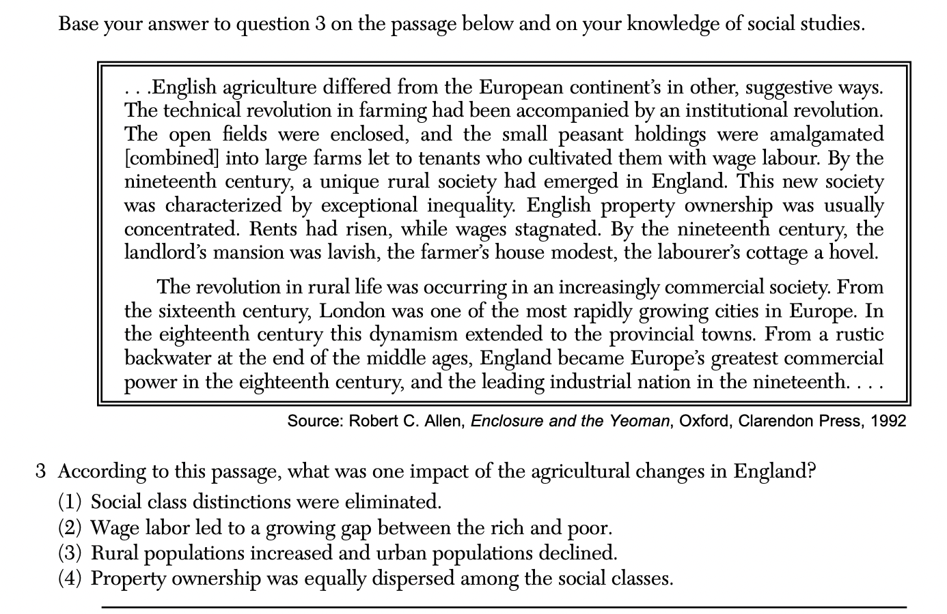

Slide 2
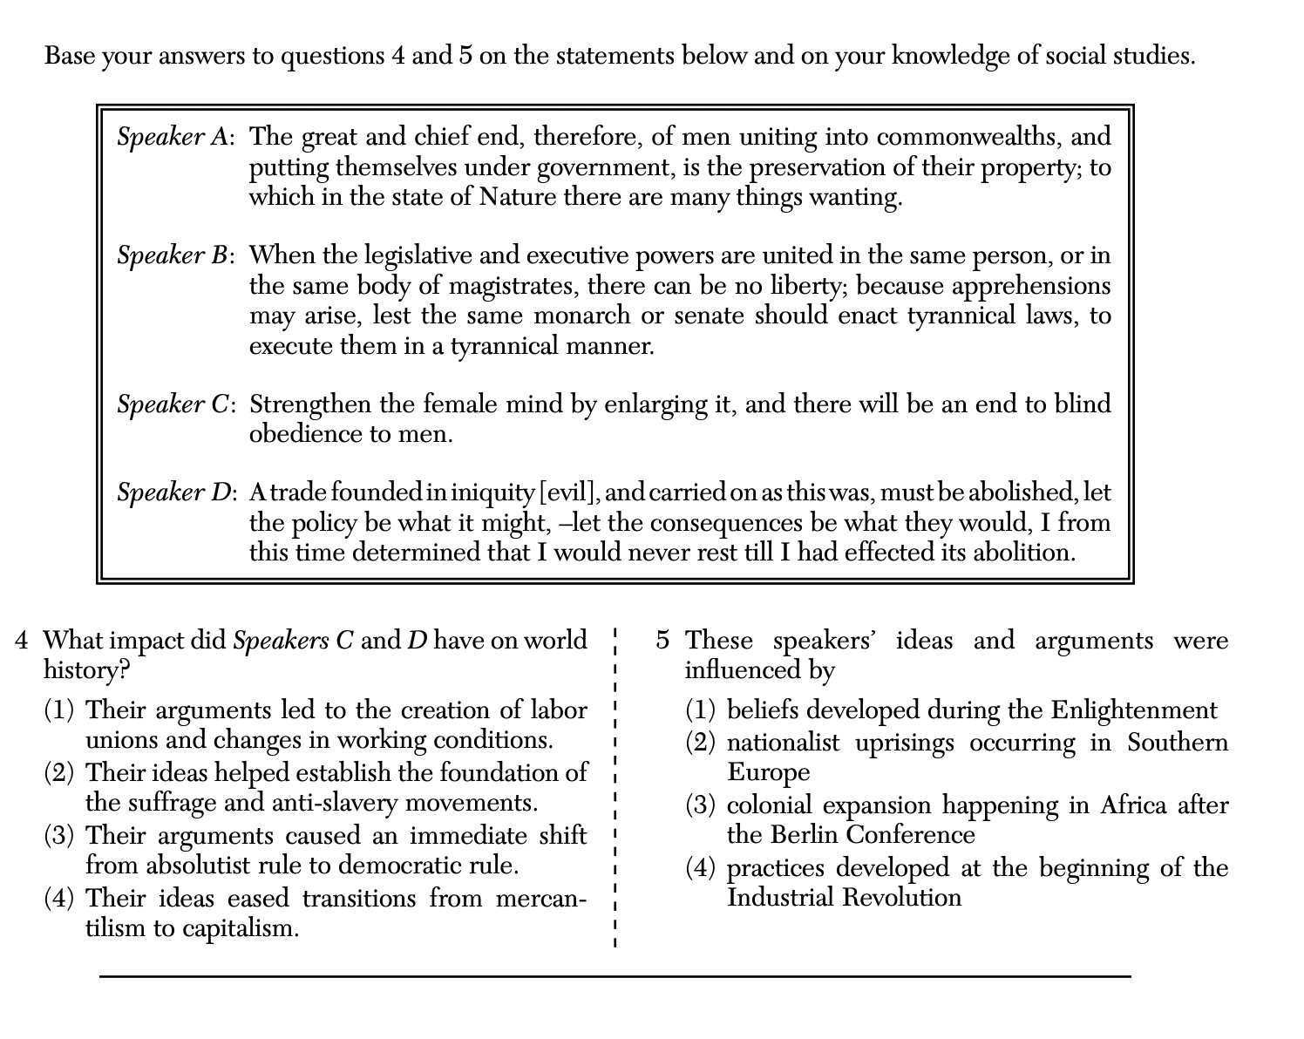

Slide 3
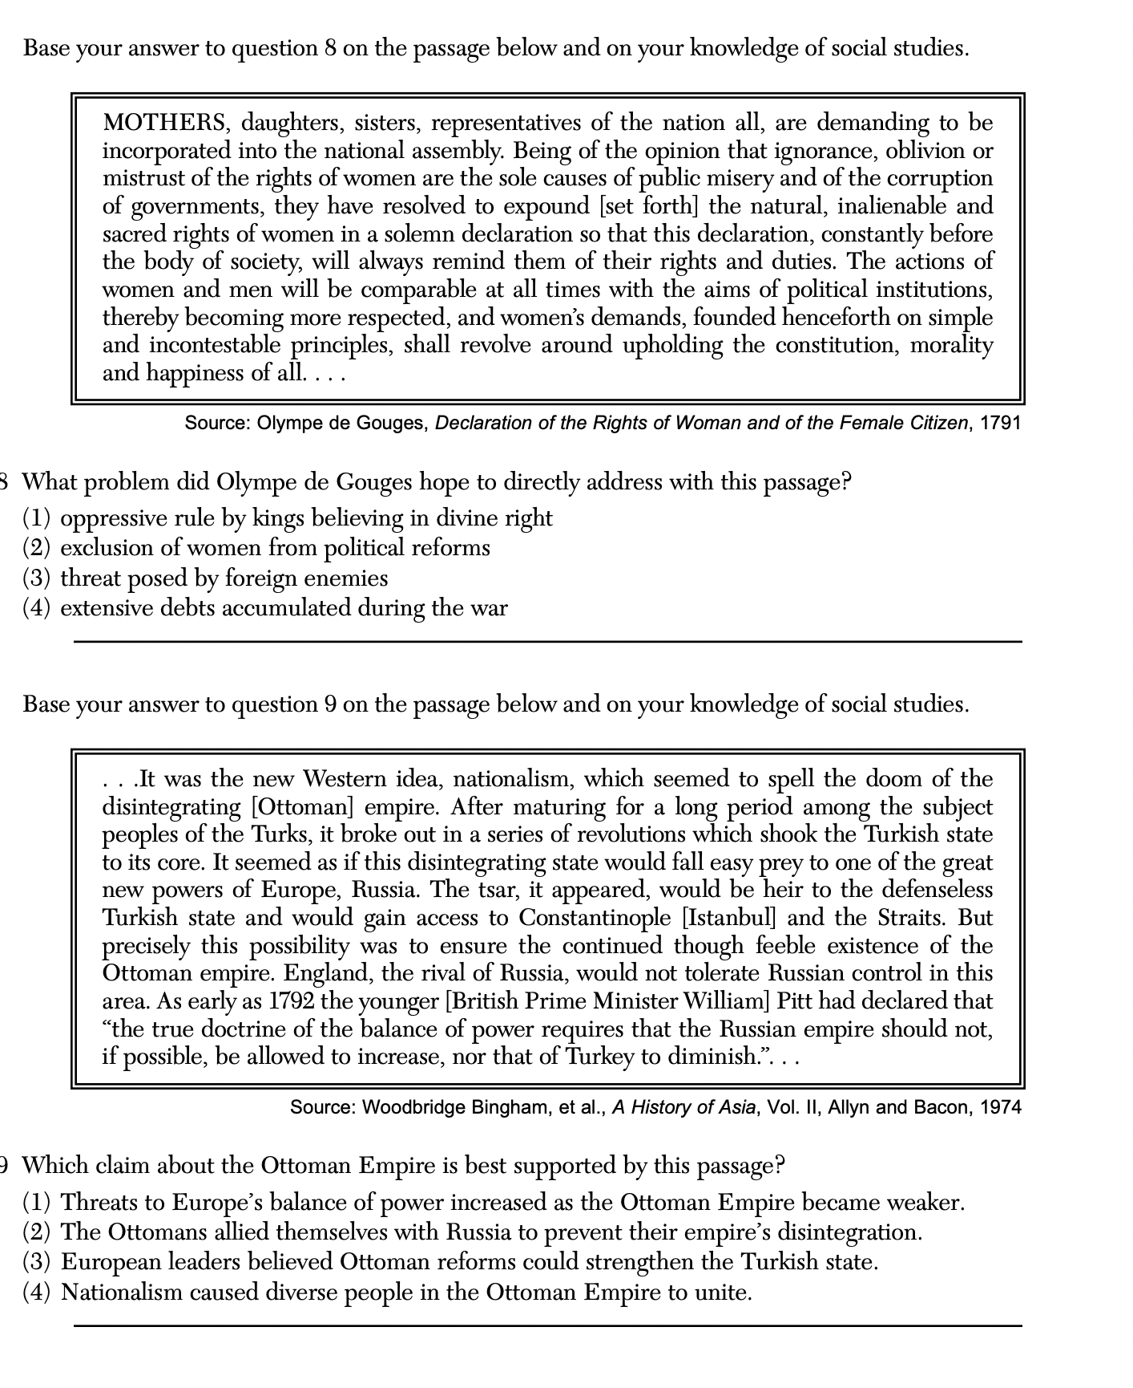

Slide 4
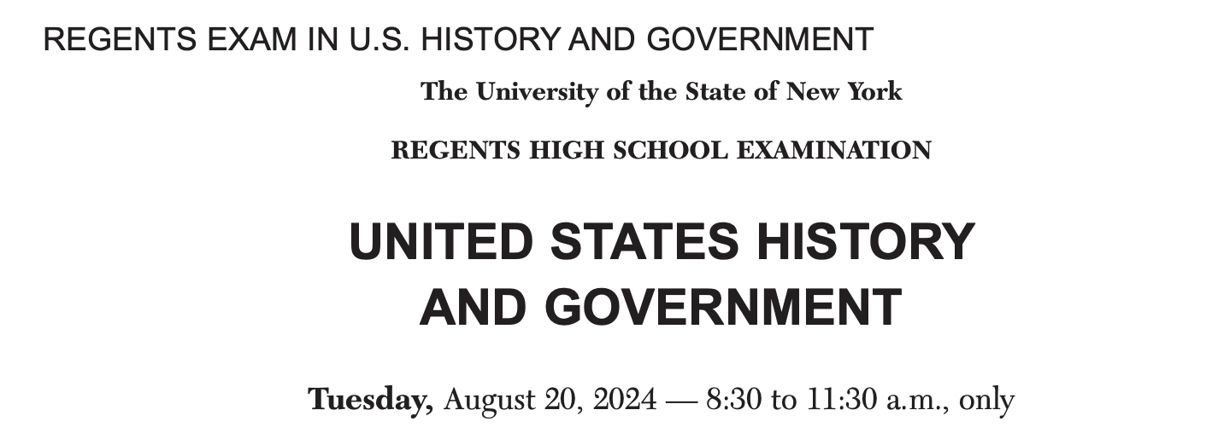
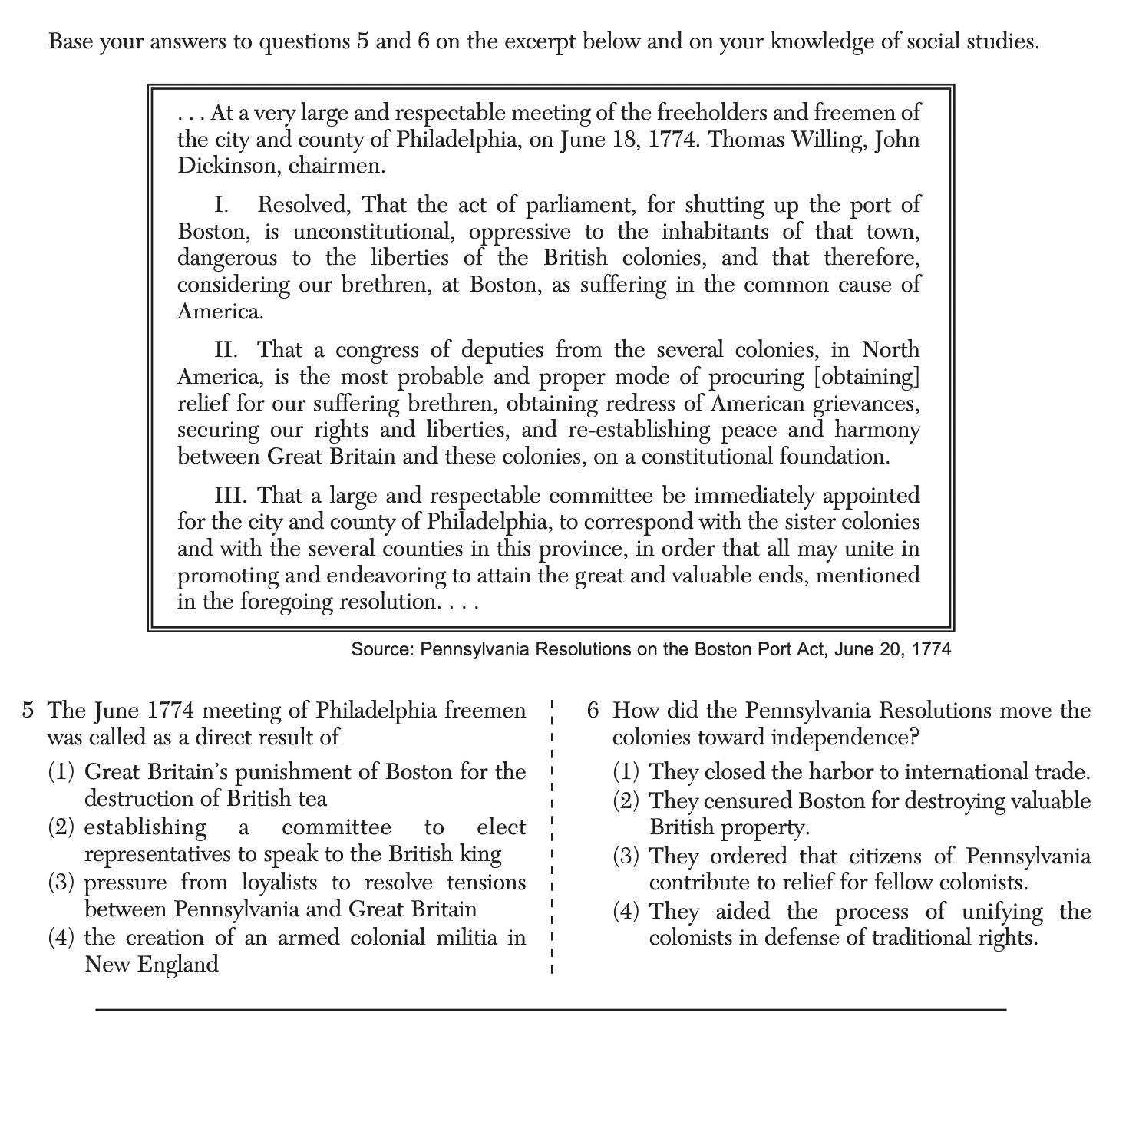

Slide 5
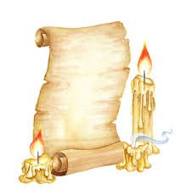
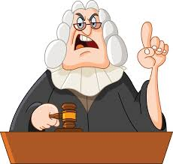
tymology
lluminates
eaning
Magistrate
Mag: more; greater
master, mastery
mister, mistress
maestro
majesty
magic

Slide 6
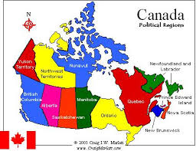
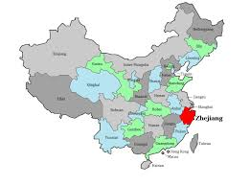
tymology
lluminates
eaning
Provincial
Pro- : on behalf of; toward; in favor of
protect
provide
promote
propose
Vince- : conquer; have control of
victory
convict
convince
invincible

Slide 7
tymology
lluminates
eaning
Magistrate
Mag: more; greater
master, mastery
mister, mistress
maestro
majesty
magic

Slide 8
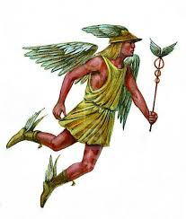
tymology
lluminates
eaning
merchant
market
commerce
commercial
mercenary
merchandise
mercantilism
Mercury:
Roman god of financial gain

Slide 9
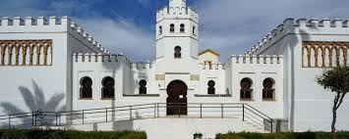
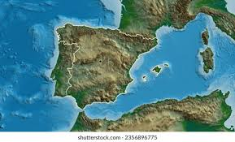
tymology
lluminates
eaning
tariff
A fee imposed on imported merchandise

Slide 10
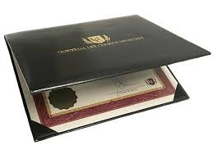
Forms:
Diplomacy
Diplomat
Diplomatic
tymology
lluminates
eaning
Diplomacy
Related Words:
Diploma
Greek Root:
Di = 2
Divide Diverse
Diverge

Slide 11
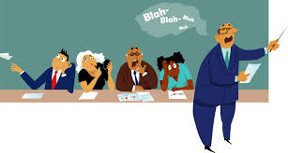
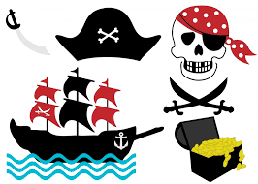
tymology
lluminates
eaning
Filibuster

Slide 12
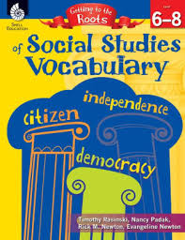

Slide 13
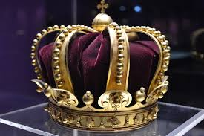
Rulers and Governments
Root: arch-,-archy
anarchy, anarchist
archaeology, archaeologist
archaic, archaism
archangel
archbishop
archduke
archenemy
architecture, architect
archival
hierarchy, hierarchical
matriarch, matriarchy
monarch, monarchy
oligarch, oligarchy
patriarch, patriarchy
Means: first, leader, oldest

Slide 14
Root: -crat, -cracy
Rulers and Governments
aristocracy, aristocrat, aristocratic
autocracy, autocrat
bureaucracy, bureaucrat
democracy, democrat, democratic
gerontocracy
gynecocracy
plutocracy, plutocrat, plutocratic
theocracy, theocrat, theocratic
kakistocracy
Means: rule, ruler

Slide 15
Root: -dic, dict-
Rulers and Governments
abdicate, abdication
addict, addiction, addictive
benediction
contradict, contradiction, contradictory
dedicate, dedication
dictate
dictator, dictatorial, dictatorship
diction, dictionary
dictum
edict
indicate, indicator, indication
indict, indictment
jurisdiction
malediction
predict, prediction, predictive
verdict
valedictorian
Means: say, speak, tell

Slide 16
Root: -judg-,judic-
Rulers and Governments
adjudicate
injudicious
judge
judgment
judgmental
judicial, judiciary
judicious
misjudge, misjudgment
nonjudgmental
prejudge
prejudice, prejudiced, prejudicial
sub judice
Means: judge, decide

Slide 17
Roots: popl-; dem(o)-
popular, populist
population, depopulation
popularity, populate
populace
populism
populous
populate
unpopular
demagogue, demagoguery
demographics, demography
epidemic
pandemic
undemocratic
Means: the people
Rulers and Governments

Slide 18
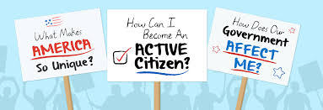
Cities and Civics
Roots: urb-; poli-,polis-
urban
suburbs, suburban
exurbs, exurban
acropolis
Annapolis, Indianapolis, Minneapolis
apolitical
cosmopolitan
politics political
policy
police
necropolis
metropolis, metropolitan
Means: city

Slide 19
Cities and Civics
Roots: civ-; cit-; milit-
civil, civilization, civilized
civics
city
citizen, citizenship
civil service, civil engineer, civil ceremony
military, militant
demilitarize
militate
militia
Means: civil; citizen
solidier, fighting, military

Slide 20
Cities and Civics
Means: to follow
Base: secu-, secut-
consecutive
consequence, consequential
execute, execution, executioner
executive
executor
inconsequential
persecute, persecution
prosecute, prosecution, prosecutor
sect, sectarian
sequel, prequel
sequence
sequential

Slide 21
Cities and Civics
Means: equal, fair
Roots: equi-; egal-
adequate, inadequate
Ecuador
egalitarian, egalitarianism
equity, equitable
equal
equator
equatorial
equidistant
equilateral
equilibrium
equinox
equivocal
equivocate
unequivocal

Slide 22
Cities and Civics
Means: flock; wholeness
Roots: greg-; integr-
aggregate
congregate, congregation
desegregate, desegregation
disintegrate, disintegration
egregious
gregarious
integer
integral
integrate, integration
integrity
reintegrate, reintegration
segregate, segregation

Slide 23
Cultures and Beliefs
Means: god
Roots: the(o)-; de(i)-; divin-
apotheosis
atheism, atheistic
deify
deism
deity
divine, divinity
monotheism, monotheist, monotheistic
pantheon, Pantheon
polytheism polytheistic
theism
theocracy, theocratic
theologian
theological
theology

Slide 24
Cultures and Beliefs
Roots: vert-; vers-
Means: turn, change
pervert, perverse, perversion
revert, reverse
subvert, subversion, subversive
traverse
universal
universe
versatile
version
vertigo
adverse, adversity
advertise, advertisement
anniversary
averse, aversion
controversy, controversial
convert, conversion
convertible
diverse, diversion
divert
extrovert
inadvertent
incontrovertible
introvert
invert, inverse, inversion

Slide 25
Cultures and Beliefs
Roots: human-; anthroprop(o)-
Means: mankind, human,
being
anthropocentric
anthropology, anthropology
anthropomorphic
misanthrope, misanthropic
philanthropy, philanthropic
human, humanity
humane
humanist, humanistic
humanities
inhuman, inhumane

Slide 26
Cultures and Beliefs
Roots: serv-, servat-; liber-, liberat-
conserve
conservation, conservationist
conservatism
conservative
conservatory
observe, observer, observation
preservation
preservative
reserve, reservation
reservoir
Means: hold, serve
free
liberals liberality
liberate, liberation
illiberal
Liberia
libertarian
libertine
liberty

Slide 27
Cultures and Beliefs
diffident, diffidence
fidelity
infidel
infidelity
mala fide
perfidy, perfidious
bonafide
confident, confidante
affidavit
confide, confidence
confidential
Roots: fid-, fidel-; cred-, credit
credit, creditor
accredit, accreditation
credible, credibility
credo
credulity
incredible
discredit
creed
Means: trust
belief

Slide 28
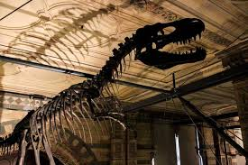
History
Roots: bell-; pac-
Means: war
peace
antebellum
bellicose
belligerence
belligerent
casus belli
postbellum
rebel, rebellion, rebellious
pact
pacifist, pacifism
pacify
Pacific

Slide 29
History
Roots: annu-; enni-
annual
annuity
annals
anniversary
biannual
bicentennial
biennial
centennial
millennium
perenial
quadrennial
semiannual
Means: year

Slide 30
Means: build
History
Root: stru-, struct-
construct, construction
construe
deconstruct, deconstruction
infrastructure
instruct, instruction, instructor
instrument
instrumental
misconstrue
obstruct, obstruction, obstructionist
substructure
superstructure
reconstruct, reconstruction
structure

Slide 31
Means: step
History
Root: grad-, gress-
aggression, aggressive, aggressor
centigrade
congress, congressional
digress, digression, digressive
egress
grade
gradient
gradual
graduate
progress, progressive
regress, regression, recessive
transgress, transgression, transgressor

Slide 32
History
Root: cid-, cis-
Means: cut, kill
concise, concision
decide, decision, decisive
excise
fratricide
herbicide
homicide
incision, incisive
infanticide
insecticide
matricide
patricide
precise, precision
regicide
sororicide
suicide
tyrannicide
uxoricide

