Slide 1
Welcome to Decent Exposure, Middle School Volume II
wary: Slide 2
recollect: Slide 3
ingenious: Slide 4
shrewd: Slide 5
listless: Slide 6
wane: Slide 7
deluge: Slide 8
belittle: Slide 9
agony: Slide 10
wrath: Slide 11
grandeur: Slide 12
appalling: Slide 13
cordial: Slide 14
grisly: Slide 15
illustrious: Slide 16
grotesque: Slide 17
saunter: Slide 18
tempest: Slide 19
prodigy: Slide 20
junction: Slide 21
massacre: Slide 22
ailment: Slide 23
laceration: Slide 24
havoc: Slide 25

Slide 2
Wary: careful and suspicious
synonyms: leery, cautious
antonyms: impulsive, careless, heedless, unwary,
forms: Noun: wariness Verb: OO
Adjective: wary Adverb: warily
related words: beware, warn
I watched his reaction
warily,
expecting more of
Some animal thing was moving in him so that he was
He was
wary
again, on guard, and mistrustful.
the fury that I had seen at his house.
cautious, and
Her eyes were
wary,
and dangerous.
wary,
reluctant.
Robert Cormier, I am the Cheese
Stephenie Meyer, New Moon
John Steinbeck, The Pearl
Stephenie Meyer, Twilight
Any form of the word wary will appear once in every 603 pages of text.

Slide 3
Recollect remember
synonyms: recall
antonyms: forget
forms: Noun: recollection, recollections
Verb: recollect, recollects, recollected,
recollecting
Adjective: 00 Adverb: 00
related words: collect
She would invoke the past, recall old
Then I
She was pretty, too, if my
recollected
how he had done quite well in his
recollections
recollections.
of her face
law practice.
and person are correct.
A painful
recollection
flashed into his mind.
Robert Penn Warren, All the King’s Men
Fyodor Dostoevsky, The Idiot
Alexander Dumas, The Count of Monte Cristo
Charlotte Bronte, Jane Eyre
Any form of the word recollect will appear once in every 140 pages of text.

Slide 4
Ingenious: brilliant
synonyms: inventive
antonyms: dull, ignorant
forms: Noun: ingenuity, ingeniousness Verb: OO
Adjective: ingenious Adverb: ingeniously
related words: genious
Ingenious,
really,l how many ways Muggles have found
The method of theft was not less
I thought about explaining to her my mother’s
ingenious
ingenious
They invented some of the machines that have since
than bold.
Edgar Allan Poe, The Purloined Letter
method of ridding the house of roaches– cracker crumbs and marshmallows.
of getting along without magic.
ingenious
troubled the world, especially the
devices for
J.K. Rowling, HP and the Chamber of Secrets
killing large numbers of people at once.
JRR Tolkien, The Hobbit
Sue Monk Kidd, The Secret Life of Bees
Any form of the word ingenious will appear once in every 265 pages of text.

Slide 5
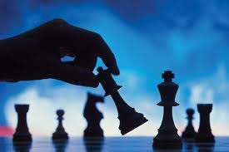
Shrewd: having a sharp mind, able to see into
people’s motivations, being able to make careful
and thoughtful decisions in one’s own interests,
not likely to be fooled
synonyms: keen, astute, sharp, perceptive,
calculating
antonyms: foolish, gullible, naïve, obtuse, dense
Forms: Noun: shrewdness Verb: 00
Adjective: shrewd Adverb: shrewdly
I glanced at him saw him looking at me with utter focus,
“Now Max,” said Nix, peering at him with a
shrewd
My boys are young, but they are very
“Hold on, Wanda,” Jeb said, his
shrewd
eyes
his eyes clear and
eye.
shrewd.
suddenly sharper.
Jodi Piccault, Change of Heart
Henry H. Neff, The Fiend and the Forge
Khaled Hosseini, The Kite Runner
Stephenie Meyer, The Host
Any form of the word shrewd will appear once in every 326 pages of text.

Slide 6
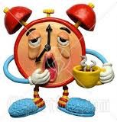
Listless: having no energy
synonyms: enervated, washed out, lazy
antonyms: energetic, alert, lively
Forms: Noun: listlessness Verb: 00
Adjective: listless Adverb: listlessly
You smell like cigarettes when you come home, you’re
The muddy waters in the after-the-flood churned
Luke gathered up Annabeth’s
“I don’t feel up to it,” said Dorian,
listless
listlessly.
body and
listless
carried her away from the goddess.
listlessly.
and distracted.
Sarah Dessen, Someone Like You
Rick Riordan, The Titan’s Curse
Oscar Wilde, The Picture of Dorian Gray
Rudolfo Anaya, Bless Me Ultima
Any form of the word listless will appear once in every 1,990 pages of text.

Slide 7
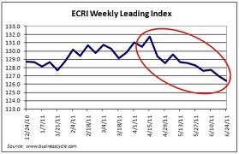
Wane: fade out; become less
synonyms: diminish, weaken, wither, recede
antonyms: intensify, grow, wax
Forms: Noun: 00 Verb: wane, wanes, waning
waned
Adjective: 00 Adverb: 00
It was dusk, and there were only a few minutes in the
Allie was unable to recognize me at any time, and I
Fewer tears had been shed because the intensity of
feeling between us had
waned
away.
waning
In the
gray light.
waning
light, Julie’s features took on a
admit my attention
waned
now and then, for most
Nicholas Sparks, Message in a Bottle
Nicholas Sparks, Dear John
pale glow.
of my thoughts were of that day we had just met.
Nicholas Sparks, Guardian
Nicholas Sparks, The Notebook
Any form of the word wane will appear once in every 886 pages of text.

Slide 8
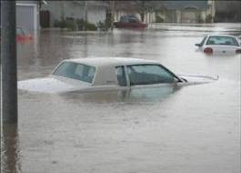
Deluge: flood Forms: Noun: deluge
Verb: 00
Synonym: inundation Adjective: deluged (by)
Antonym: drought Adverb: 00
The mere thought of the word provoked a shot of pain
The sound of his voice, serious and husky, brought
In autumn, on the other hand, we have
The
deluge
continues as if the Gamemakers are
deluges
intent on washing us all away.
behind my eyes and a
with it a
of mud.
deluge
of memories of the night, and I felt
deluge
of saliva in my mouth.
Suzanne Collins, The Hunger Games
Albert Camus, The Plague
a blush color my face and neck.
Yann Martel, Life of Pi
Stephenie Meyer, Breaking Dawn
Any form of the word deluge will appear once in every 1,018 pages of text.

Slide 9
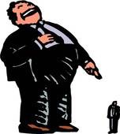
Belittle: make someone feel small and worthless
synonyms: berate, insult, discourage
antonyms: flatter, boost, fawn over, compliment, praise, encourage
Forms: Noun: 00 Verb: belittle, belittles, belittling, belittled
Adjective: 00 Adverb: 00
You just knew, by the expression of her face, by the
She had known all along, when she criticized the mink
belittle
belittled
Others were so full of themselves that they
People often
the place where they were born.
steely narrowing of her eyes, the heavy, enunciated
jacket, when she
belittled
his freckles and
their partners.
sighs that could be so
belittling,
that words, any words,
Randy Pausch, The Last Lecture
Mitch Albom, The Five People You Meet in Heaven
complained about his drinking habits.
seemed preferable to him.
Amy Tan, The Joy-Luck Club
Sara Dessen, Just Listen
Any form of the word belittle will appear once in every 4,482 pages of text.

Slide 10
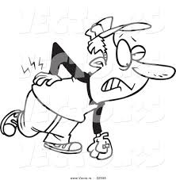
Agony: severe, prolonged pain
Forms: Noun: agony, agonies
Verb: agonize, agonizes, agonized
agonizing
Adjective: 00 Adverb: 00
Everybody in the game knew the difference between
His face contracted in
The
He groaned and twisted in
agony
of pain was more than I could bear.
agony,
agony.
and sweat streamed
a yell of pain and a scream of
agony.
down his face.
Darren Shan, A Vampire’s Assistant
S.E. Hinton, The Outsiders
Rudolfo Anaya, Bless Me Ultima
David Almond, Skelleg
Any form of the word agony will appear once in every 193 pages of text.

Slide 11
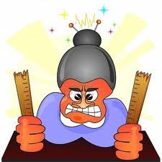
Wrath: anger
synonyms: rage, fury
Forms: Noun: wrath Verb: 00
Adjective: wrathful Adverb: wrathfully
Do it, or feel my
Gray Beaver’s
wrath
wrath.
yourself.
was terrible; likewise was
If you were to try, would that not yet again incur the
She stood shivering beneath the torrent of her mother’s
White Fang’s wrath.
wrath
of the dragons yet again?
wrath.
J.K. Rowling, HP and the Deathly Hollows
Jack London, White Fang
James A. Owen, Here There Be Dragons
Stephen Crane, Maggie: A Girl of the Streets
Any form of the word wrath will appear once in every 215 pages of text.

Slide 12
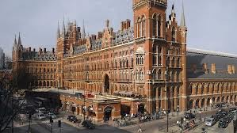
Grandeur: great beauty and majesty, either
natural or man-made
synonyms: ostentation, glory, magnificence
antonyms: simplicity, ordinariness
Forms: Noun: grandeur Verb: 00
Adjective: grand Adverb: grandly
We watched in silence the beauty and
How maddening it was to be born in a cotton field with
My days are consumed by war--its awful scale and
The great hall was a sight, stunning in its
grandeur
grandeur.
of the great fish.
aspirations of
grandeur--
and yet the littlest things make such a
grandeur.
Maya Angelou, I Know Why the Caged Bird Sings
Rudolfo Anaya, Bless Me Ultima
James A. Owen, Here There Be Dragons
difference.
Henry H. Neff, The Maelstrom
Any form of the word grandeur will appear once in every 502 pages of text.

Slide 13
Appalling: shocking, horrifying
synonyms: mortifying, shameful, disgraceful
antonyms: soothing, reassuring, gratifying
Forms: Noun: 00 Verb: appall, appalls,
appalled, appalling
Adjective: 00 Adverb: appallingly
And then you’re such an
He was
I stared at him, confused and
There was an
appalled,
appalling
completely shocked, and so was
appalling
crash as they struck water
appalled.
liar.
far below.
Axe.
Marcus Luttrell, Lone Survivor
Stephenie Meyer, New Moon
Henry H. Neff, The Maelstrom
Stephenie Meyer, The Host
Any form of the word appall will appear once in every 531 pages of text.

Slide 14
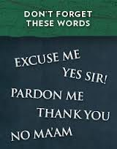
Cordial: polite
synonyms: courteous, friendly, warm
antonyms: rude, boorish, uncouth, aloof
Forms: Noun: cordiality Verb: 00
Adjective: cordial Adverb: cordially
Origin: cord: heart
There is, of course, no reason at all to suppose that
I did not want any of that kind of trouble, and to keep a
He learned to be
cordial
to everybody—
And thank you so much for your
cordial,
a sophisticated and ultimately false front.
our meeting will be anything less than
cordial
cordial
distance would be best.
professional handling of this situation.
Kazuo Ishiguro, Remains of the Day
David Guterson, Snow Falling on Cedars
Sarah Dessen, The Lullaby
Margaret Atwood, Alias Grace
Any form of the word cordial will appear once in every 280 pages of text.

Slide 15
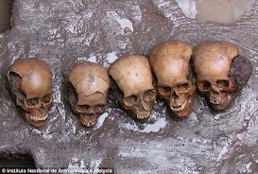
Grisly: horrifyingly bloody,sickeningly violent
synonym: gruesome, macabre
antonyms: pleasant, gentle, soft
It was understandably a nightmare, a monster of the
The pictures in my head had turned so
Despite such
grisly
sights, the ward was peaceful.
The
grisly
grisly
murders--”I turned away from the
grisliest
kind.
TV coverage and I had to sigh out loud.
that I couldn’t bear it.
The Eclipse, Stephenie Meyer
The Host, Stephenie Meyer
The Maelstrom, Henry H. Neff
Kiss the Girls, James Patterson
The word grisly will appear once in every 3,296 pages of text.

Slide 16
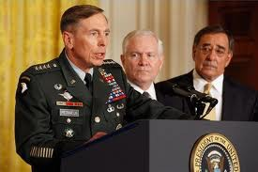
Illustrious: famous and repected; highly accomplished
synonym: revered
antonym: disgraced, lowly
Etymology: from lustr-, meaning light or shine
I knew he was feeling that this was just more
That was probably true, for my husband was of
Your
illustrious
associate Morse is drooling down
time failed to live up to his
illustrious
illustrious
lineage in his homeland, a fact
my neck.
father’s expectations?
implicit even in his name.
And here is our
illustrious
relative from Boston…
J.D. Robb, Glory in Death
The Ultimate Gift, Jim Stovall
Not Without My Daughter, Betty Mahmoody
Robert Ludlum, The Bourne Ultimatum
The word illustrious appears once in every in 427 pages of text.

Slide 17
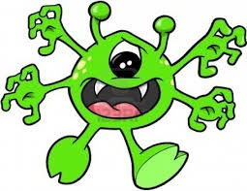
Grotesque: horribly abnormal
synonym: distorted
antonym: normal, beautiful
Forms: Noun: 00 Verb: 00
Adjective: grotesque
Adverb: grotesquely
My hands are misshapen and
grotesque
His skin was a
grotesque
grotesque
No one even dared to look at his
shade, a fading blueberry.
face.
Malfoy made a
now, and they throb during most of my waking hours.
grotesque
face, his mouth sagging
open and his eye rolling.
The Five People You Meet in Heaven, Mitch Albom
Holes, Louis Sachar
The Notebook, Nicholas Sparks
HP and the Order of the Phoenix, J.K. Rowling
The word grotesque will appear once in every 640 pages of text.

Slide 18
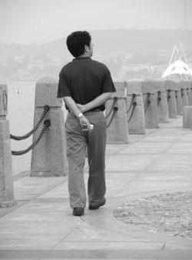
Saunter: walk in a slow, casual, leisurely way
synonym: amble, stroll
antonym: march
Forms: Noun: OO Verb: saunter, saunters, sauntered
sauntering
Adjective: 00 Adverb: 00
Charlie
sauntered
out to the car, muttering
At this moment the Unicorn
Totally guilt free, I
HORNBECK
saunters
saunter
on, chewing on an apple.
up the stage steps.
about impatience.
sauntered
by them, with his hands in his pockets.
Eclipse, Stephenie Meyer
Identical, Ellen Hopkins
Inherit the Wind, Robert E. Lee and Jerome Lawrence
Through the Looking Glass, Lewis Carroll
Any form of the word saunter will appear once in every 1,004 pages of text.

Slide 19
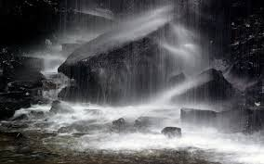
Tempest: storm
Forms: Noun: tempest, tempests Verb: 00
Adjective: 00 Adverb: 00
As they watched, the
We were
tempest
-tossed and storm-torn,
tempest’s
In his mind a
Paul took a deep breath, trying to still the
tempest
roared: a whirlwind of
wrath struck him like a hammer blow.
as the poets say.
tempest
within him.
flashing blades and severed limbs .
Nine Princes in Amber, Roger Zelazny
Christopher Paolini, Brisingr
Dune, Frank Herbert
Eragon, Christopher Paolini
Any form of the word tempest will appear once in every 374 pages of text.

Slide 20
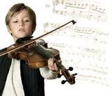
Prodigy: a a child with extraordinary talent in a specific area, usually
the arts, mathematics, science, or sports
Related to: produce, prodigious (fruitful, producing a great amount)
And when I lost, I was filled with growing dread, and
Is that my cue to say something like, you
must have been a child
prodigy
then terror that I was no longer a
?
that I had
prodigy,
I said to myself, ‘Larten, there goes a most
lost the gift and had turned into something ordinary.
Nineteen Minutes, Jodi Piccault
remarkable child, a true
prodigy.’
The Joy-Luck Club, Amy Tan
You were a mechanical
prodigy
A Living Nightmare, Darren Shan
and a weapons master.
Any form of the word prodigy will appear once in every 474 pages of text.
Lord of Light, Roger Zelazny

Slide 21
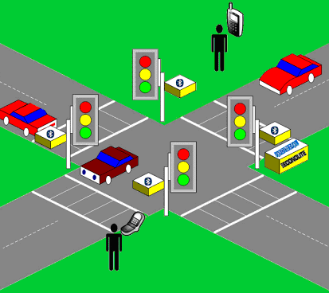
Junction: point of intersection
Related words: juncture, conjunction
Etymology: junct, meaning joining
He paused as a
junction
of two paths and
The trial
junction
was shaded by a row of trees
The truck headed toward an intersection that had signs
She limped down the corridor--she was beginning to
looked around for some sign of Fleur.
and tail brush.
marking a
junction.
feel the ache of true exhaustion in her legs and arms
Tim O’Brien, The Things They Carried
J.K. Rowling, HP and the Goblet of Fire
James Patterson, The Angel Experiment
at the
junction
of the stairs.
Cassandra Clare, City of Bones
Any form of the word junction will appear once in every 718 pages of text.

Slide 22
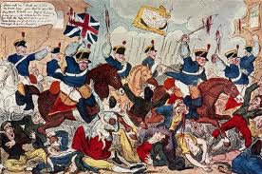
Massacre: an event in which multiple people are
brutally murdered
near-synonym: slaughter
It explains any number of
massacres,
wars, executions.
Janice shouted through her hands, “Someone stop
And Billy had seen the greatest
massacre
It was nothing less than a
in human history, which was the bombing of Dresden.
this
massacre!”
massacre.
Marcus Lutrell, Lone Survivor
Kurt Vonnegut, Slaughterhouse-Five
Chang-Rae Lee, Native Speaker
Don Delillo, White Noise
Any form of the word massacre will appear once in 477 pages of text.

Slide 23
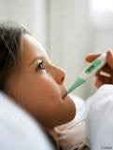
Ailment: sickness, disease, pain
Synonym: malady
Forms: Noun: ailment, ailments
Verb: ail, ails, ailed, ailing
Adjective: 00 Adverb: 00
Not surprisingly, they tended to shrug when patients
died of
ailments
like measles or tenanus or TB.
A benign cyst, it was not a life-threatening
ailment
Tracy Kidder, Mountains Beyond Mountains
but it was unsightly, to say the least.
Next, she offered: What herb cures all
ailments
?
Nicholas Sparks, Nights in Rodanthe
The benches are always packed with people talking
Christopher Paolinni, Eldest
about their
ailments.
Frank McCourt, Angela’s Ashes
Any form of the word ailment will appear once in 1,438 pages of text.

Slide 24
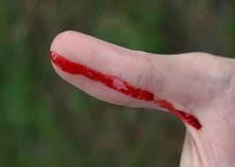
Laceration: cut in the skin; wound
Forms: Noun: laceration, lacerations
Verb: lacerate, lacerates, lacerated, lacerating
Adjective: 00 Adverb: 00
There were three splotches of blood below the
The knife swerved as a result, leaving her with a long,
You suffered thirteen wounds, a broken shoulder, a
keyhole from his
lacerated
knuckles.
jagged
fractured skull, a
The worst
laceration
laceration
lacerated
twice as deep as the others.
was on your upper lip.
kidney, and I’ll still
Stephen King, The Shining
Chrisopher Paolini, Brisingr
wager that you recover within a week.
Henry H. Neff, The Maelstrom
Khalid Hosseini, Kite Runner
Any form of the word laceration will appear once in every 2,928 pages.

Slide 25
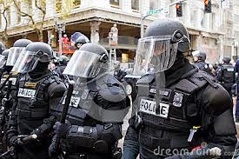
Havoc: a state of massive violence and confusion
Synonym: mayhem
Antonym: tranquility, peace, serenity
Expression: to wreak (reek) havoc
Peeves was the school poltergeist, a grinning, airborne
The storms have always raged across Florida, wreaking
The folk he’d made were evil, they’d gone all wrong,
Since they have moved into the open, they have been
havoc,
menace who lived to cause
and then died somewhere overland on the Gulf.
havoc
and distress.
wreaking
havoc.
havoc
they were wreaking
in the world.
J.K. Rowling, HP and the Chamber of Secrets
David Almond, Clay
J.K. Rowling, HP and the Half-Blood Prince
David Eggers, Zeitoun
The word havoc will appear once in every 1,324 pages of text.

