Slide 1
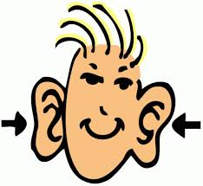
Accelerated Auditory Patterning

Slide 2
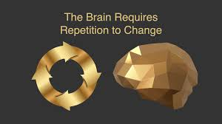

Slide 3
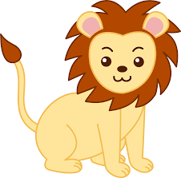
I went to the zoo and I saw a

Slide 4
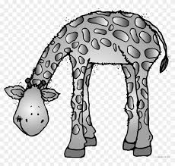
I went to the zoo and I saw a

Slide 5
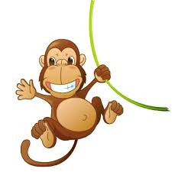
I went to the zoo and I saw a

Slide 6
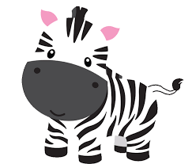
I went to the zoo and I saw a

Slide 7
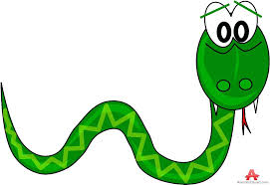
I went to the zoo and I saw a

Slide 8
I went to the zoo and I saw a

Slide 9
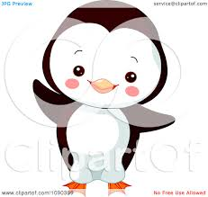
I went to the zoo and I saw a

Slide 10
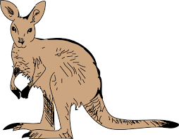
I went to the zoo and I saw a

Slide 11
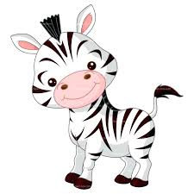
I went to the zoo and I saw a

Slide 12
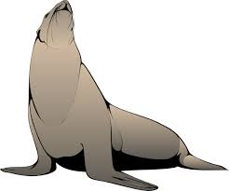
I went to the zoo and I saw a

Slide 13
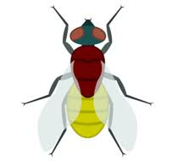
I went to the zoo and I saw a

Slide 14
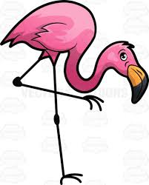
I went to the zoo and I saw a

Slide 15
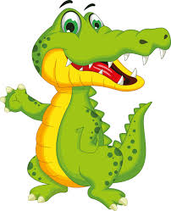
I went to the zoo and I saw a

Slide 16
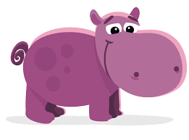
I went to the zoo and I saw a

Slide 17
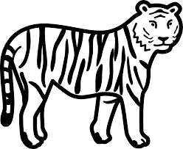
I went to the zoo and I saw a

Slide 18
I went to the zoo and I saw a

Slide 19
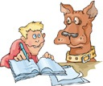
Rusty and I went to the…

Slide 20
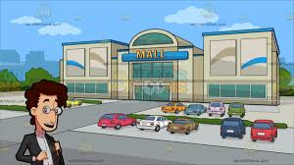
Rusty and I went to the…

Slide 21
Rusty and I went to the…

Slide 22
Rusty and I went to the…

Slide 23
Rusty and I went to the…

Slide 24
Rusty and I went to the…

Slide 25
Rusty and I went to the…

