Slide 1
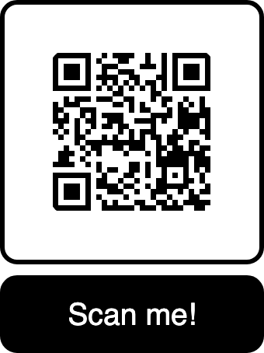
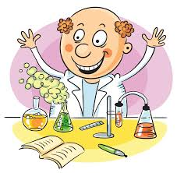
December 11, 2024
ES BOCES
A Workshop for Secondary ELA, ENL, and Special Education Teachers
Topics:
I. What SoR is and is not
II. Background: The Controversies
III. Elements of reading instruction
IV. Language Arts Skills Relevant to Reading
*Building Fluency
*Vocabulary Growth
*Spelling as a Reading Skill
*Grammar to Support Reading Skills

Slide 2
“Science of Reading” is an approach to reading instruction that integrates findings from cognitive
science (how the human brain learns), linguistics, and education.
“Science of Reading” emphasizes the development of the following skills, which evolves throughout
the years of education:
Phonemic awareness:
The auditory skill of being able to differentiate sounds in words
Recognizing rhyming and non-rhyming groups of words
Recognizing words having the same sounds:
cat, kite, quiche, chord, chemistry
beat, read, clear, creek, steam
biology, ecology, geology, astrology, radiology
Recognizing words in a group that don’t belong, based on
their sounds:
scatter, matter, batter, other, chatter, tatter
Being able to sort words based on similarity of sound:
mother, gather, other, leather, brother,
heather, rather

Slide 3
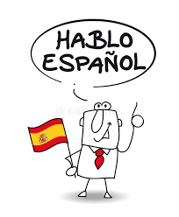
Sounds in English that a Spanish-speaker may have trouble distinguishing
because they are not common in the Spanish language:
sh
h
th (unvoiced)
judge
consonant clusters at the beginning of words

Slide 4
Phonics:
The reading-writing skill of associating letters with specific sounds that they represent.
English: 75% phonetic
(75% of English words have reliable, predictable letters-to-sound relationships)
Almost 100% phonetic

Slide 5
“Whole Language” “Balanced Literacy” “TC Readers-Writers Workshop”
“Three-Cueing” “Leveled Literacy” “Reading Recovery”
“Units of Study” “Rebalancing Literacy” “Advancing Literacy”
“Basal Readers”
Minimal direct instruction in phonemic awareness, phonics,
spelling, grammar, punctuation, word components, and vocabulary;
Instead, heavy reliance on the theory that reading is a natural process
and that children will “learn to read by reading”
Belief that grammar, spelling, and vocabulary are “caught, not taught”

Slide 6
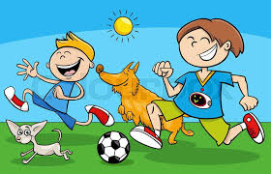
The text says:
Jason and Jackson are playing soccer with their pets on a
beautiful sunny day.
Child, using “meaning cue” reads:
Jason and Jackson are playing soccer with their dogs on a
nice day outside.
Child, using “structure cue” reads:
Jason and Jackson play soccer with their pets on a
beautiful sunny day.
Child, using “visual cue” reads:
Two brothers are playing soccer with their pets on a
beautiful sunny day.

Slide 7
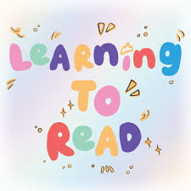
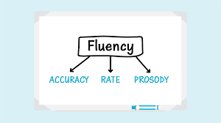
Elements of Reading Instruction
Word Level: Decoding
Comprehension: Understanding
Author’s Intent
Phonics: Letters represent sounds
Discerning central ideas and
supportive information
Sight words: Letters do not
necessarily represent sounds
Ability to summarize
Ability to discern tone
Basic spelling
Ability to answer questions
Basic vocabulary
Ability to read between the lines
Basic understanding of
what punctuation and
capitalization are
meant to do
Knowing 90-95% of the vocabulary
Sufficient background knowledge

Slide 8
For fluent readers, all words are
sight words. The purpose of phonics
instruction is so you don’t have to
consciously use it anymore.
Why these strategies work:
They all model and reinforce pace,
accuracy, and expressiveness in a
low-anxiety structure.
Deficit indicators:
Strategies for improvement:
I. Wide reading: When reading something we
are interested in, we know a lot of the words.
This familiarity allows us to use context to learn
unfamiliar words; builds confidence
Robotic (word-by-word,
expressionless) reading
aloud
I. Choral Reading:
1. Whole class
2. Teacher reads every other sentence
3. “Just the boys”; “Just the girls” alternating
4. Cumulative: First one reader, then add a few
more, then a few more
II. Deep reading: Fluency develops as a
result of repeated readings; practice increases
speed
Inaccuracies, especially
in mistaking words spelled
similarly in the first few
letters
II. After teacher reads aloud, with students’
eyes on text, students talk about what the
teacher did to make the words on the page
come alive
III. Multiple re-reads: What did you notice on consecutive readings?
Skim, Scan, Read
Reading too slowly to
maintain comprehension:
The effort that it takes to
consciously decode words
takes away from the focus
on meaning
III. Learn to “ear read”: activate the inner voice
IV. Focus on how the punctuation enhances
meaning by grouping words together and
directing expression: ex.: How does your
voice and pacing change when you see a
comma? What does a semicolon indicate?
V. Poor readers read words. Skillful readers
read phrases. Teacher marks off phrases.
Then, read it again, with increasingly
fewer mark-offs.

Slide 9
Which of these is the better way to spend class time prior to a reading experience?
Let’s go over our 6 reading strategies:
Let me demystify what you are about to read.
Make predictions: Anticipate what comes next
as you read.
Highlight a few specific words, exceeding brief definitions.
(examples, explanations, etymology, breakdown into
word components)
2. Visualize and mentally hear the text as you read.
3. Ask questions about the text as you read.
Explain necessary facts about the world that bear upon
the meaning of the text.
4. Make connections: Text-to-self
Text-to-the world
Text-to-other texts
Informational Text: Give students time to skim to get an
overview; scan to find specific information
Literary Text: Guide students through confusing and subtle
points (“This chapter is a flashback”; “In this chapter we
have a different speaker”; “We’re meeting a new character”;
“We’re in a different setting”; “This chapter is philosophical”)
5. Summarize verbally or in writing periodically and
after reading the whole thing.
6. Monitor your own comprehension and do what you
need to do to understand: reread, adjust your
reading environment, use an outside resource, help
yourself focus

Slide 10
“How To Read Faster” by Malia Wollon
NYT, March 17, 2020
Surprises
Questions
Affirmations
Words
(Hmmmm….I never knew this or thought about it
this way.)
(I already knew this, but it’s good to have
it expressed and/or
expanded on by an expert.)
(3 words in the text that I would like
to know more about.)
(I wonder about; I’m not sure about; I disagree with)

Slide 11
“The Real Magic of Spelling: Improving Reading and Writing”
From: American Educator, Winter, 2008-2009
Surprises
Questions
Affirmations
Words
(Hmmmm….I never knew this or thought about it
this way.)
(I already knew this, but it’s good to have
it expressed and/or
expanded on by an expert.)
(3 words in the text that I would like
to know more about.)
(I wonder about; I’m not sure about; I disagree with)

Slide 12
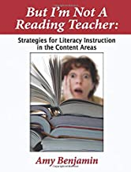
Literary Words
Generic Academic
Words
Glossary
Words

Slide 13
Knowing the meaning of
individual words
Understanding the
world of words
Having fun with words

Slide 14
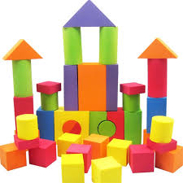
Build Semantic Networks
Etymology
Forms
Word
Connotation
Visuals
Prefix, Root,
Suffix
Context
Collocation
Synonyms/Near Synonyms
Antonyms/Near Antonyms
Personal connections
and associations

Slide 15
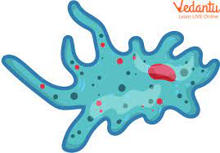
Draw an Amoeba
How would you
describe the shape
of an amoeba?
blobby
blob-like
New Words:
atypical
atheist
anarchy
anonymous
asymmetrical
shapeless
amorphous

Slide 16
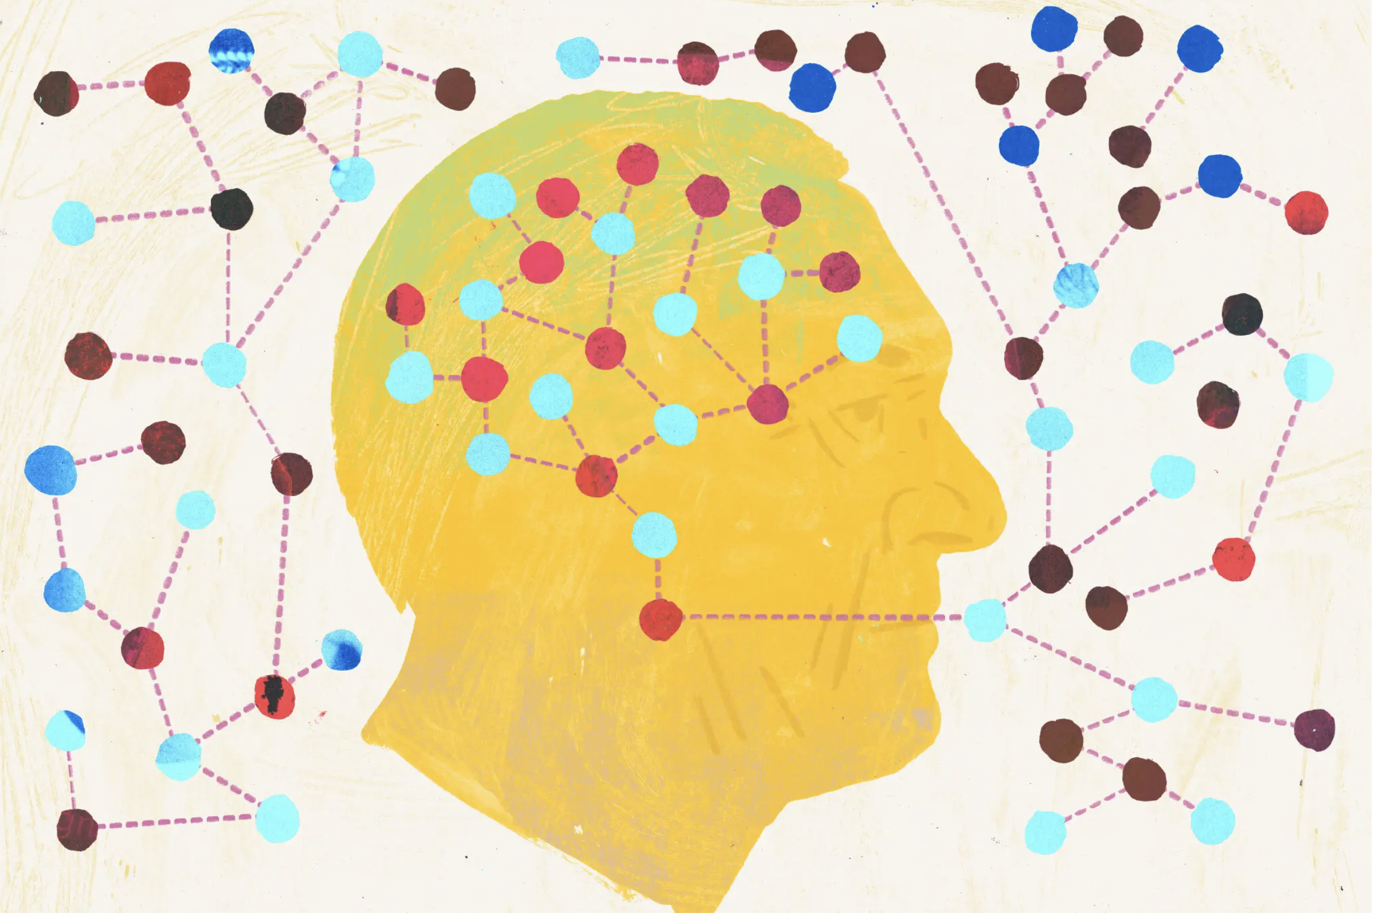

Slide 17
More Numbers:
6;30
Number of exposures to a new word during the initial lesson;
Number of exposures during the ensuing month
10-15%
Your chances of learning a word after a single exposure in context
2-3
Realistic number of words learned in a school day through explicit instruction
90-95%
Percentage of words that need to be known for the text to be
considered “instructional level” for that reader
20
Number of paragraphs of instructional level text that need to be read to
add one word to your vocabulary
8-3000
Number of words that schoolchildren need to learn every day
(3000 words per year)
25-1-1000
A fifth grader who spends 25 minutes a day reading will grow
her vocabulary by 1,000 words in a year.

Slide 18
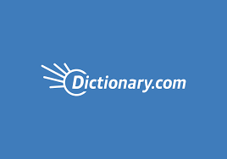
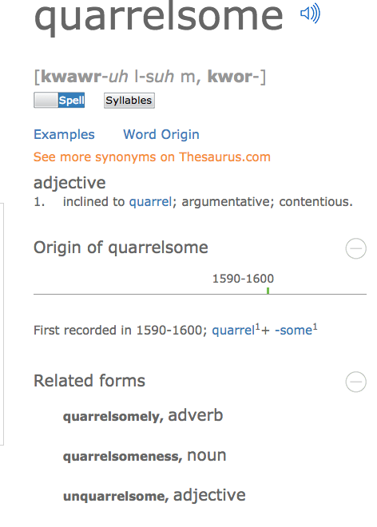

Slide 19
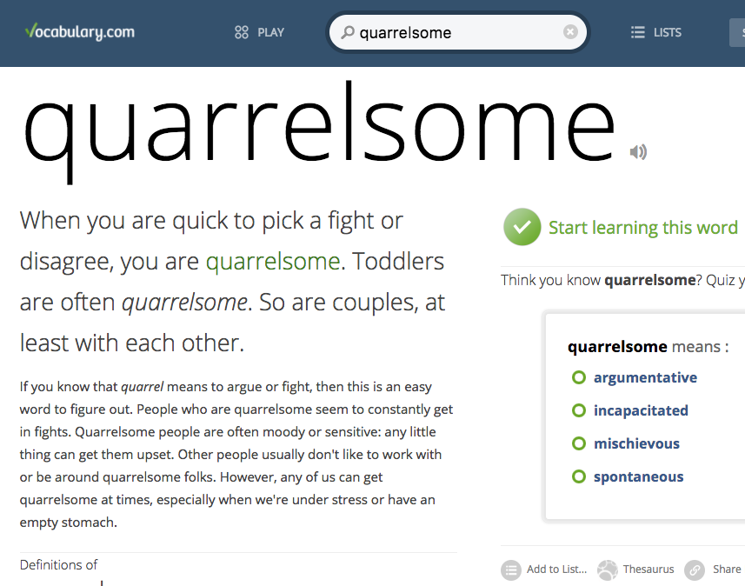

Slide 20
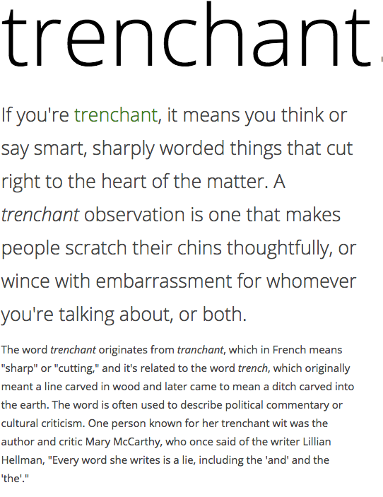

Slide 21
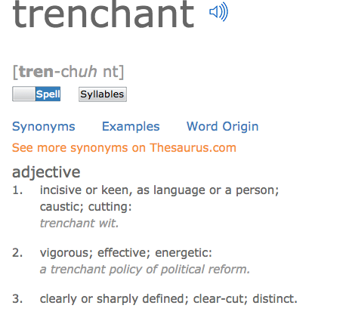

Slide 22
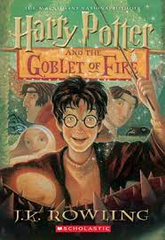
Find the word that means:
In Paragraph 1: called in____________________
boiled over________________________
obvious___________________________
bothered (3 words)________________________
obviously___________________________
seemingly___________________________
In Paragraph 2: bar___________________
lively business (2 words)___________________
shown up (2 words)_______________________
emotionally_______________________________
In Paragraph 3: shabby_____________________
The police were summoned, and the whole of Little
Hangleton had seethed with shocked curiosity and
ill-disguised excitement. Nobody wasted their breath
pretending to feel very sad about the riddles, for they had
been most unpopular. Elderly Mr. ad Mrs. Ridddle had been
rich, snobbish, and rude, and their grown-up son, Tom,
had been, if anything, worse. All the villagers cared about
was the identity of their murderer for plainly, three
apparently healthy people did not all drop dead of natural
causes on the same night.
(2) The Hanged Man, the village pub, did a roaring trade
that night; the whole village seemed to have turned out to discus the murders.
They were rewarded for leaving their firesides when the Riddles’ cook arrived
dramatically in their midst and announced to the suddenly silent pub that a man
called Frank Bryce had just been arrested.
“Frank!” cried several people. “Never!”
(3) Frank Bryce was the Riddles’ gardener. He lived alone in a rundown
cottage on the grounds of the Riddle House. Frank had come back from the
war with a very stiff leg and a great dislike for crowds and loud noises, and
had been working for the Riddles ever since.

Slide 23
Getting to Know the Words We Meet in Reading:
The word I would like to get to know is:
My guess:
Dictionary Definition:
(Use vocabulary.com, preferably)
Visual:
Draw a very quick picture:
Definition in my own words:
Complete sentence of at least 10 words:
Must contain an action verb and a visual image.

Slide 24
The Academic Word List (AWL):
Background: The Academic Word List consists of 570 word families that are not in the most
frequent 2,000 words of English but which occur frequently over a very wide range of academic texts.
These 570 word families are grouped into ten subsets that reflect word frequency.
A word like analyze falls into Subset 1, which contains the most frequent words, while the word
adjacent falls into Subset 10 which includes the least frequent (among this list of high incidence words).
The AWL is not restricted to a specific field of study. That means that the words are useful for learners
studying in disciplines as varied as literature, science, health, business, and law.
This high-utility academic word list does not contain technical words likely to appear in one,
specific field of study such as amortization, petroglyph, onomatopoeia, or cartilage.
Two-thirds of all academic English derive from Latin or Greek.
Understandably, knowledge of the most high-incidence academic words in English can significantly
boost a student’s comprehension level of school-based reading material. Students who are taught
these high-utility academic words and routinely placed in contexts requiring their usage are likely
to be able to master academic material with more confidence and efficiency, wasting less time and
energy in guessing words or consulting dictionaries than those who are only equipped with the most
basic 2000-3000 words that characterize ordinary conversation.
The following link gives you a two-page version of the list:
http://www.doe.in.gov/TitleI/pdf/Word_List_Feldman.pdf
Source: Coxhead, Averil. (2000). A new academic word list. TESOL Quarterly, 34, 213-238.

Slide 25
Academic Word List: Subset 1
analyze, approach, area, assess, assume, authority, available, benefit, concept, consist, context, constitute, contract, data, define, derive, distribute, economy, environment, establish, estimate, evident, factor, finance, formula, function, income, indicate, individual, interpret, involve, issue, labor, legal, legislate, major, method, percent, period, principle, proceed, process, policy, require, research, respond, role, section, sector, significant, similar, source, specific, structure, theory, vary
Spanish Cognates:
analizar, el área, asumir, la autoridad, el beneficio/beneficiar, concepto, consistir, contexto, constituir, datos, definir, derivar, distribuir, la economía, establecer, estimar/estimado, evidente, la función, las finanzas, la fórmula, el indice, el individuo, interpretar, envolver, laborar, legal, legislar, el método, ocurrir, el por ciento, el período, principio, proceder, el proceso, requerir, responder, rol, sección, sector, significativo/significante, específica, estructura, la teoría, variar

Slide 26
Academic Word List: Subset 1
analyze, approach, area, assess, assume, authority, available, benefit, concept, consist, context, constitute, contract, data, define, derive, distribute, economy, environment, establish, estimate, evident, factor, finance, formula, function, income, indicate, individual, interpret, involve, issue, labor, legal, legislate, major, method, percent, period, principle, proceed, process, policy, require, research, respond, role, section, sector, significant, similar, source, specific, structure, theory, vary
Academic Word List: Subset 3
alternative, circumstance, comment, compensate, component, consent, considerable, constant, constrain, contribute, convene, coordinate, core, corporate, correspond, criteria, deduce, demonstrate, document, dominate, emphasis, ensure, exclude, fund, framework, illustrate, immigrate, imply, initial, instance, interact, justify, layer, link, maximize, negate, outcome, philosophy, physical, proportion, publish, react, register, rely, scheme, sequence, shift, specify, sufficient, technical, technique, valid, volume
Academic Word List: Subset 2
achieve, acquire, administrate, affect, appropriate, aspect, assist, category, chapter, commission, community, complex, compute, conclude, conduct, consequence, construct, consume, credit, culture, design, distinct, equate, element, evaluate, feature, final, focus, impact, injure, institute, invest, item, journal, maintain, normal, obtain, participate, perceive, positive, potential, previous, primary, purchase, range, region, regulate, relevant, reside, resource, restrict, secure, seek, select, site, strategy, survey, tradition, transfer

Slide 27
Academic Word List: Subset 4
access, adequacy, annual, apparent, approximate, attitude, attribute, civil, code, commit, concentrate, confer, contrast, cycle, debate, despite, dimension, domestic, emerge, ethnic, grant, hence, hypothesis, implement, implicate, impose, integrate, internal, investigate, mechanism, occupy, option, output, overall, parallel, parameter, phrase, prior, principal, professional, project, promote, regime, resolve, retain, series, statistic, status, stress, subsequent, undertake
Academic Word List: Subset 5
academy, adjust, alter, amend, capacity, clause, compound, consult, decline, discrete, enable, energy, enforce, entity, equivalent, evolve, expand, expose, external, facilitate, fundamental, generate, liberal, license, logic, margin, modify, monitor, network, notion, objective, orient, perspective, precise, prime, psychology, pursue, ratio, reject, revenue, stable, style, substitute, sustain, symbol, target, transit, trend, version, welfare, whereas
Academic Word List: Subset 6
abstract, acknowledge, accuracy, aggregate, allocate, assign, bond, capable, cite, cooperate, discriminate, display, diverse, domain, edit, enhance, estate, exceed, explicit, federal, fee, flexible, furthermore, gender, incentive, incorporate, incidence, index, inhibit, initiate, input, interval, mitigate, minimum, ministry, motive, neutral, nevertheless, overseas, precede, presume, rational, recover, reveal, scope, subsidy, trace, transform, underlie, utilize

Slide 28
Academic Word List: Subset 7
adapt, advocate, channel, classic, comprehensive, comprise, confirm, contrary, convert, decade, deny, differentiate, dispose, dynamic, equip, eliminate, empirical, extract finite, foundation, gradient, guarantee, hierarchy, identical, ideology, infer, innovate, insert, intervene, isolate, media, mode, paradigm, phenomenon, priority, prohibit, publication, quote, release, reverse, simulate, sole, somewhat, submit, successor, thesis, transmit, ultimate, unique, voluntary
Academic Word List: Subset 8
abandon, accompany, accumulate, ambiguous, appendix, appreciate, arbitrary, automate, bias, chart, clarify, commodity, complement, conform, contemporary, contradict, crucial, currency, denote, detect, deviate, displace, eventual, exhibit, exploit, fluctuate, guideline, implicit, induce, inevitable, infrastructure, inspect, intense, manipulate, minimize, nuclear, offset, predominant, prospect, radical, reinforce, restore, revise, tension, terminate, theme, thereby, uniform, vehicle, via, virtual, widespread
Academic Word List: Subset 9
accommodate, analogy, anticipate, assure, attain, behalf, cease, coherent, coincide, commence, compatible, concurrent, confine, controversy, converse, device, devote diminish, distort, duration, erode, ethic, found, format, inherent, insight, integral, intermediate, manual, mature, mediate, medium, military, minimal, mutual, norm, overlap, passive, portion, preliminary, protocol, qualitative, refine, restrain, revolution, rigid, route, scenario, sphere, subordinate, supplement, suspend, trigger, unify, violate
Academic Word List: Subset 10
adjacent, albeit, assemble, collapse, colleague, compile, conceive, convince, depress, encounter, forthcoming, incline, integrity, intrinsic, invoke, levy, likewise, nonetheless, notwithstanding, ongoing, panel, persist, pose, reluctance, so-called, straightforward, undergo, whereby

Slide 29
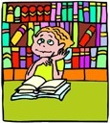
Prior Knowledge: How well do I know these words?
Strangers
Acquaintances
Friends

Slide 30
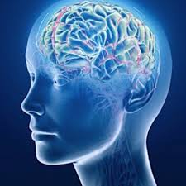
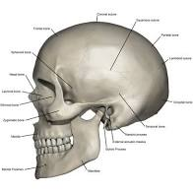
cranium
Talk with your neighbor about how
bicycle riders can protect their craniums.

Slide 31
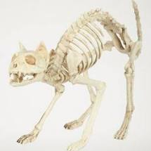
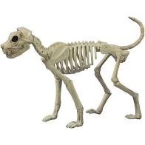
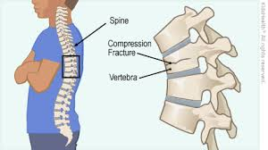
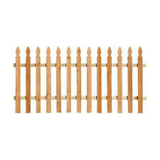
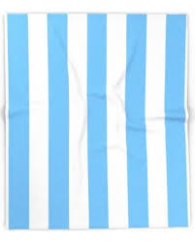
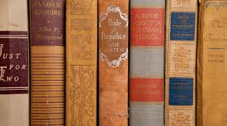
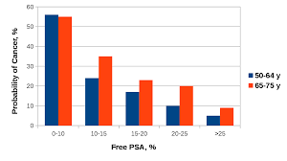
2 of 5
vertebra
vertebrae
Talk with your partner.
All of the pictures to the
right show vertical lines.
How would you describe
vertical lines?

Slide 32
3 of 5
imprint
Talk with your neighbor about why
your shoes make an imprint on sand
and not on the street.

Slide 33
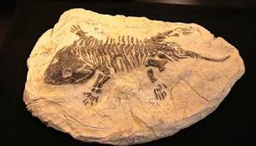
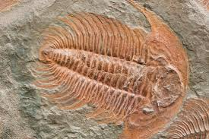
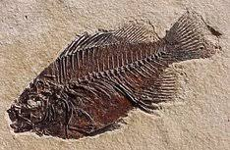
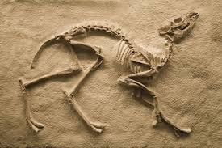
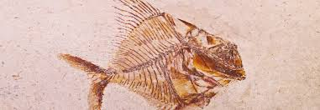
4 of 5
fossil
Talk with you neighbor about what you
might do if you found a fossil on the
beach.

Slide 34
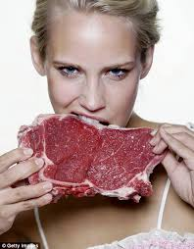
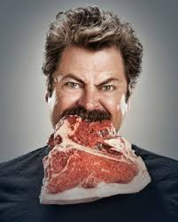
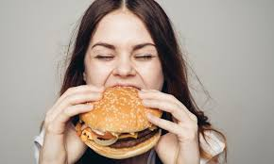
carnivore
Talk to your neighbor about animals that
you know are carnivores.

Slide 35
vis: see

Slide 36
supervision
television
visual
supervise
visualize
visibly
vision
visible
visualization
invisible
invisibility
revise
visit
revision
revisit
vista
advisor
vis: see

Slide 37
grad, gress: step

Slide 38
gradient
regress
graduate
progress
gradually
progression
gradual
progressive
gradual
gradually
transgress
aggressive
graduation
digress
grade
upgrade
digression
downgrade
congress
grad, gress: step

Slide 39
phon: sound
audio: hearing

Slide 40
symphony
auditory
audit
phonics
audio-visual
phonetic
audition
xylophone
auditorium
audiologist
homophone
audience
telephone
(phone)
audiobook
saxophone
megaphone
microphone
phon: sound
audio: hearing

Slide 41
tract: pull away

Slide 42
subtract, subtraction
intractable
extract, extraction
distract, distraction
attract, attractive, attraction
traction
tractor
contract, contraction
retract, retraction
tract: pull away; pull together

Slide 43
ject: throw

Slide 44
subject to; subjected to
eject, ejection
inject, injection
reject, rejection
projector, projection
adjective
trajectory
interject, interjection
projectile
conjecture
ject: throw

Slide 45
form: shape, arrangement

Slide 46
formula
conform, conformist, nonconformist
formal, informal
reform, reformer
formation
inform, information
uniform, uniformity
formulate
format
transform, transformer,
transformation
formless
deform, deformity
perform, performer,
performance
form: shape, arrangement

Slide 47
pel/pul: to drive or drive out

Slide 48
repel, repellent
repulsive
propel, propeller
propulsion
expel, expulsion
pulse, pulsate
compel, compulsive
impel, impulse
impulsive
dispel
pel/pul: to drive or drive out

Slide 49
scrip/scrib: write

Slide 50
script, scripted, unscripted
prescribe,
prescription
inscribe,
inscription
describe,
description
manuscript
scribble
subscribe,
subscription
scrip/scrib: write

Slide 51
vert: turn

Slide 52
converse,
conversation
traverse
anniversary
invert, inversion
adversary
convert,
conversion,
convertible
revert, reversion
versatile, versatility
averse, aversion
versus
divert, diverse,
diversity, diversion
introvert, extrovert
vers, vert: turn

Slide 53
port: carry; door

Slide 54
transport, transportation
support, supportive
port
import
export
portal
report, reporter
opportunity
deport,
deportation
portable
important, importance
report
passport
portfolio
airport
port: carry; door

Slide 55
spec, spect: to look at

Slide 56
specify, specification
specific
spectator
prospect
expect,
expectation
aspect
suspect
respect
special, especially
specialize
inspect,
inspector,
inspection
introspective
perspective
spectacle
retrospect
struct: build

Slide 57
struct: build

Slide 58
instrument, instrumental
obstruct, obstruction, obstructive
infrastructure
structure, structural
structured,
unstructured
instruct, instructor, instruction
restructure
construct, construction, constructive
reconstruction
destruction,
destructive
struct: build

Slide 59
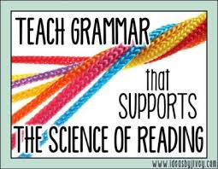
Morphology Charting
“Baseball Sentence Building”
Analyze the REASONS for
punctuation in authentic
text.

Slide 60
Morphology Chart
NOUNS: They will fit into this frame: The_____. | VERBS: They will fit into this frame: To____ or Can____or Is____ing | ADJECTIVES: They will fit into this frame: The ________truck | ADVERBS: They will fit into this frame: Do it ___________.
Nouns answer the question: What? or Who?
Verbs answer the question: What is it doing, having, feeling, or being?
Adjectives answer the question: What kind? (They may also answer the questions Which one? and
How many? but those kinds of adjectives do not fit into
the frame of The______truck.
Adverbs answer any of these questions: Where? When? Why? To what extent? How?

Slide 61
Morphology Chart
NOUNS: They will fit into this frame: The_____. | VERBS: They will fit into this frame: To____ or Can____or Is____ing | ADJECTIVES: They will fit into this frame: The ________truck | ADVERBS: They will fit into this frame: Do it ___________.
Nouns answer the question: What? or Who?
Verbs answer the question: What is it doing, having, feeling, or being?
Adjectives answer the question: What kind? (They may also answer the questions Which one? and
How many? but those kinds of adjectives do not fit into
the frame of The______truck.
Adverbs answer any of these questions: Where? When? Why? To what extent? How?

Slide 62
Morphology Kit
Noun-Making Suffixes | Verb-Making Suffixes | Adjective-making suffixes
-ment -ness -ation, sion -ity -ism -hood -itude -ence -ance -ide | -ate -ify -ize | -acious,icious -y -ous, ious -ant -able, ible -er; est
Adverb-making suffix:
-ly
5

Slide 63
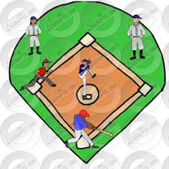
“Sentence-Building Baseball”
Hit a single:
Simple sentence (1 clause*)
Who or what is the
sentence about?
What about it?
Clause: Subject (noun phrase) + Predicate (verb phrase)
Elephants love peanuts.
Penguins waddle.
Most elephants will eat just about anything.
Emperor penguins of Antarctica waddle on the glacial ice.

Slide 64
“Sentence-Building Baseball”
Hit a double:
Compound sentence (2 clauses
joined by a coordinating conjunction*)
Coordinating Conjunctions: and, but, so
Use a comma or semicolon to join the two clauses.
Elephants love peanuts, and that includes the shells.
Penguins waddle; whales glide.
Most elephants will eat just about anything, but giraffes are more selective.
Emperor penguins of Antarctica waddle on the glacial ice; blue whales glide
through the waves in sweeping, elegant arcs.

Slide 65
“Sentence-Building Baseball”
Hit a triple:
Complex sentence (Main clause +
subordinate (aka dependent) clause
joined by a subordinating conjunction*)
Subordinating Conjunctions: AAAWWUUBBI
as, after, although
while, when
unless, until
because, before
if
since
Most elephants will eat just about anything because they are voracious carnivores.
Because they are voracious carnivores, most elephants will eat just about anything.

Slide 66
“Sentence-Building Baseball”
Hit a home run:
Compound-Complex sentence
Most elephants will eat just about anything because they are voracious carnivores,
so you can throw them peanuts, shells and all.
Because most elephants are voracious carnivores, they will eat just about anything;
you can throw them peanuts, shells and all.

Slide 67
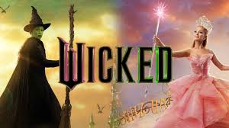
Use the cues of punctuation
Find the word
that means:
(in order)
established
iconic
great adventure story
depressing sameness
danger
intense desire
change
deeply set in
movie
fame
colored
striking piece of
entertainment
attractions
colorful and lively
interesting
musically
off-key
absurdly
part of a sequence
massive force
probably
With its flying monkeys and magical shoes, oh my, the story of the Wizard of Oz has been lodged
in the popular imagination for over a century. It is, after all, an archetypal American myth: an epic
of good and evil, the comfort (and dreariness) of home, the draw (and freedom) of the road, the
perils of power and the yearning for transformation. The 1939 film with Judy Garland, in particular,
is so embedded in the American cinematic DNA that it’s inspired everyone from Martin Scorsese
to David Lynch, Spike Lee and John Waters, who once called (accurately!) the wicked witch
“every bad little boy’s and girl’s dream of notoriety and style.”
I wonder what Waters will make of “Wicked” and its green-hued, deeply sincere heroine, Elphaba,
a ready-made meme machine played by Cynthia Erivo in what becomes a showstopper of a
performance. Both the character and the actress are the strongest draws in this splashy, largely
diverting, tonally discordant and unconscionably long movie, which is the first installment in a
two-part adaptation of the Broadway show “Wicked.” That juggernaut opened at the Gershwin
Theater in 2003 and shows no signs of (ever) closing; it will presumably still be raking it in when
“Wicked Part Two” is set to open in November 2025.
Assuming that your students have some familiarity with “The Wizard of Oz” what background
knowledge would be helpful here?

Slide 68
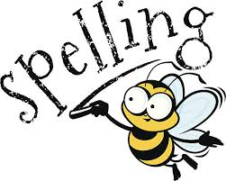

Slide 69
Some Reasons for Spelling Problems
ELL: Spanish: Spell what you hear; consistent rules
2. Hearing deficits: auditory discrimination problems will affect spelling
“supposably”
3. Pronunciation problems: If you mispronounce a word, you probably misspell it
“probaly”
“liberry”
4. Lack of sufficient experience as a reader. Visuals of spelling are not
fully imprinted unless you read enough.
“athalete”
“expresso”
5. Poor teaching:
1. Lists of orthographically unrelated words (no patterns)
2. Missed opportunities for “eyes on text” while listening to read-aloud
3. Missed opportunities to connect spelling to etymology, rules, patterns,
and morphology
4. “Spelling doesn’t count” attitude
5. Not varying the modes through which spelling is learned
“mischivious”

Slide 70
“The Real Magic of Spelling: Improving Reading and Writing”
From: American Educator, Winter, 2008-2009
Surprises
Questions
Affirmations
Words
(Hmmmm….I never knew this or thought about it
this way.)
(I already knew this, but it’s good to have
it expressed and/or
expanded on by an expert.)
(3 words in the text that I would like
to know more about.)
(I wonder about; I’m not sure about; I disagree with)

Slide 71
This information is about:_____________________________________________
Surprises
Questions
Affirmations
Words
(Hmmmm….I never knew this or thought about it
this way.)
(I already knew this, but it’s good to have
it expressed and/or
expanded on by an expert.)
(3 words in the text that I would like
to know more about.)
(I wonder about; I’m not sure about; I disagree with)

Slide 72
Core Strategies for English Language Learners (and everyone else)
Develop academic
vocabulary with the
All-Stars List:
Provide
comprehensible
input
Provide opportunities
for meaningful use of
English.
Ensure a
low affective filter
Front-load
vocabulary prior
to a read-aloud
Implementation:
Use selected words from
the list naturally, in the
course of speaking to the
children. Repeat the words
as much as possible, in
various contexts and forms.
Implementation:
Provide sufficient and
helpful visuals, including
gestures, facial expressions,
expressive voice, slow
speech.
Toggle between the new
word and a familiar
definition of it.
Implementation:
Frequent turn-and-talks
with clear prompts. Model
turn-and-talks (I do it,
we do it, you do it)
Implementation:
Be a “warm demander”;
Prevent stress and
anxiety by using positive
classroom management
techniques; have a
consistent attitude of
friendliness, enthusiasm,
and patience
Implementation:
Select 3-5 key words
that will appear in the
text. Teach these words
using visuals. Present
the concept before naming
the word. (You: “There’s a
name for this.”
Students: “We call it…”
You: (show and say the word)
Spanish Cognates
Implementation:
Where possible, point
out the Spanish sound-
alike (cognate).
Amy Benjamin Educational Services, Inc. 2023

